Slide 1

Twitter Research updates, 2020-12-02
Mark torres

Slide 2
Outline
Past Work
General Approach
Data Collection
Exploratory Data Analysis
Topic Models
(Possible) Next Steps
All scripts stored at https://github.com/ngandhi01/TextMining

Slide 3
Features used in past research
User text
Text itself
Proportion of positive/negative words
Proportion of keywords (e.g., “depression”, “anxiety”)
Images in the tweet
User Twitter behaviors/characteristics
What time did they post?
How many tweets are they posting?
How many of their posts are RTs, @ mentions, replies?
How many followers do they have?
Demographics

Slide 4
Problem statement
Part 1: Can we classify the sentiment of a person’s tweets during COVID?
Part 2: Can we use the sentiment of a person’s tweets during COVID to predict their location?

Slide 5
Possible project approach
Part 1: Scrape and Use multimodal data:
Tweet text
User information / Twitter behavior
Demographics / location
Topic assignment of tweet (from LDA, topic models)
Part 2: Pass into model to classify the sentiment of a person’s tweets
Part 3: Get the location of the person and see what covid-related events were happening during that time (e.g., did they have a covid spike? Did the governor institute a lockdown?)
Part 4: Use the sentiment of a person’s tweets (or, average daily sentiments of a person’s tweets) and correlate with covid-related events in their location (e.g., were their tweets more sad/angry when lockdowns were announced?)
Part 5: Predict a person’s location based on the sentiment of their tweets (likely with a neural network)

Slide 6
Data collection
Scraped three sets of tweets:
2020-11-25: Scraped 25,000 COVID tweets (keywords: covid19, coronavirus, lockdown)
2020-11-30: Scraped 35,000 depression tweets (keywords: depression, anxiety, fear, worry, distress, suicide, pain)
2020-11-30: Scraped 35,000 miscellaneous tweets (keywords: happy, alive, brave, confident, sport, office, animal, meal, computer)
After data cleaning (e.g., removing RTs, @ mentions), the number of tweets in each set was:
COVID tweets (2020-11-25): 8,178 (original: 25,000)
Depression tweets (2020-11-30): 15, 777 (original: 35,000)
Miscellaneous tweets (2020-11-30): 14, 811 (original: 35,000)
Note: this dataset hasn’t been used yet. It might be used in the future as a “control” dataset of tweets not referring to either mental health or to COVID
Total number of tweets: 38, 766

Slide 7
Text Preprocessing steps
1. Remove RTs, verified accounts (filters out ~60% of tweets)
2. Stemming/Lemmatization
3. Remove links, mentions to users (@ mentions)
4. Remove punctuation
5. Remove stopwords

Slide 8
Exploratory data analysis

Slide 9
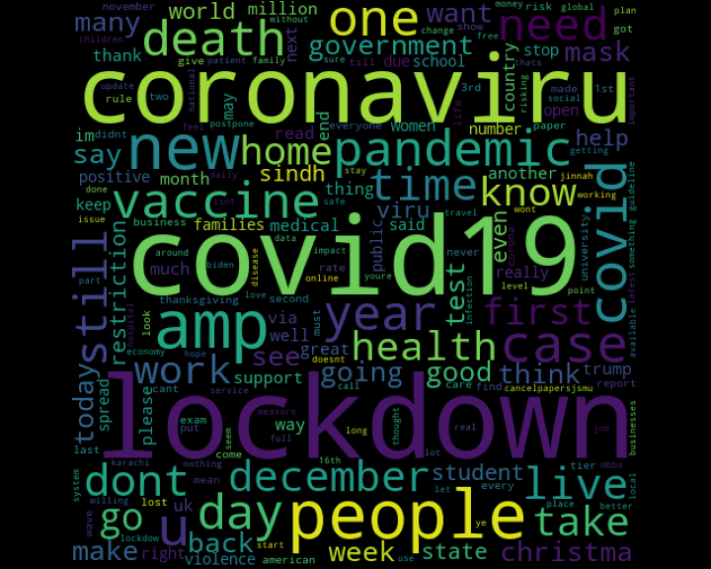
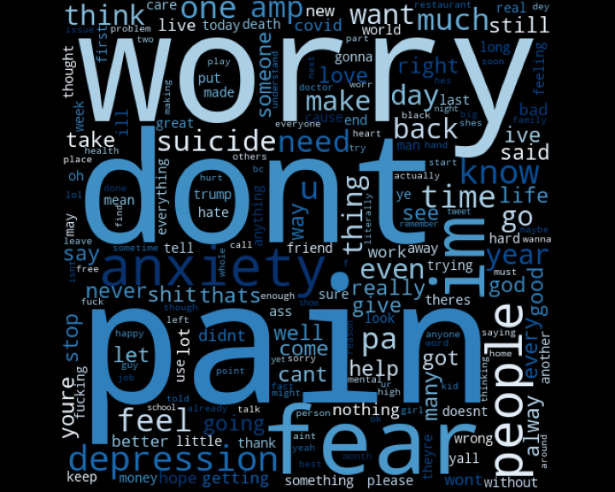
Word clouds
COVID tweets, November 25th, 2020
Mental health tweets, November 30th, 2020

Slide 10
Topic model (COVID)

Slide 11
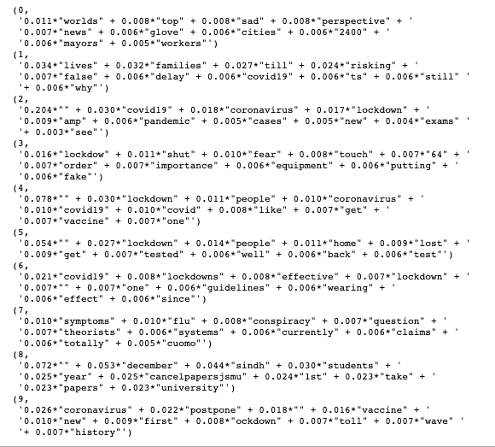
Topic model (COVID)

Slide 12
Topic model (Mental health)

Slide 13
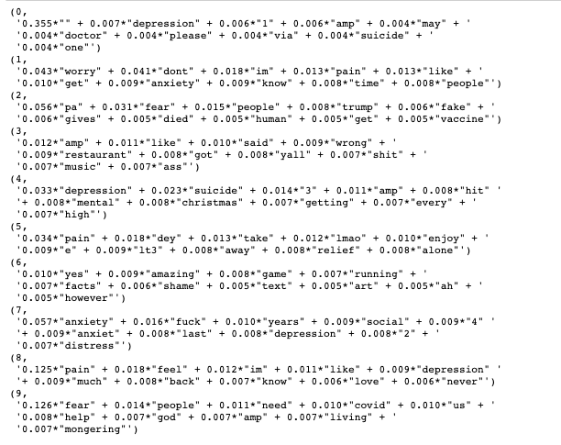
Topic model (Mental health)

Slide 14
Current questions in approach
1. How do we control for other things that people might post about?
E.g., people might be posting about politics, protests, and other current events that aren’t necessarily going to be related to covid events
2. How many tweets do we need?
3. How many users do we need to look at?

Slide 15
Next steps
1. scrape tweets / use pre-scraped tweets from start of covid to present
2. Gather data on what point in time certain events happened in certain states (E.g., lockdowns, spike in number of cases, etc.) as well as general trends in cases/deaths over time for a given location
3. train a sentiment analysis model (or fine-tune existing model) to detect the sentiments of tweets

Slide 16
Fin

